Slide 1
BIO-MEDICAL WASTE

Slide 19
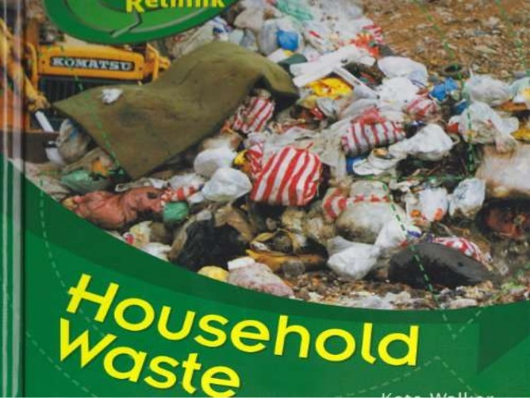

Slide 24
EFFECT OF BIO-MEDICAL WASTE ON ENVIRONMENT

Slide 28
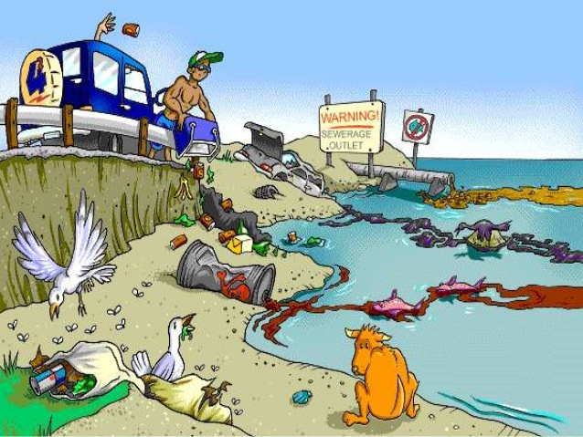

Slide 30
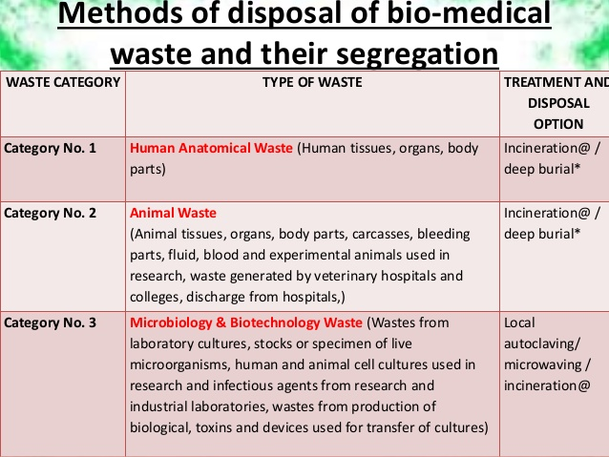

Slide 31
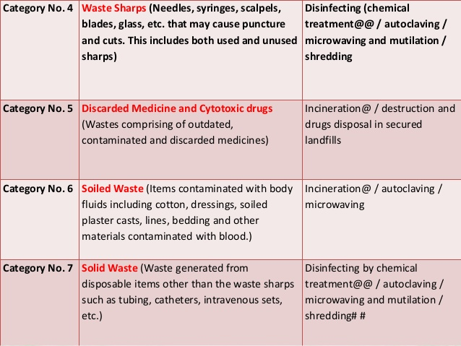

Slide 32
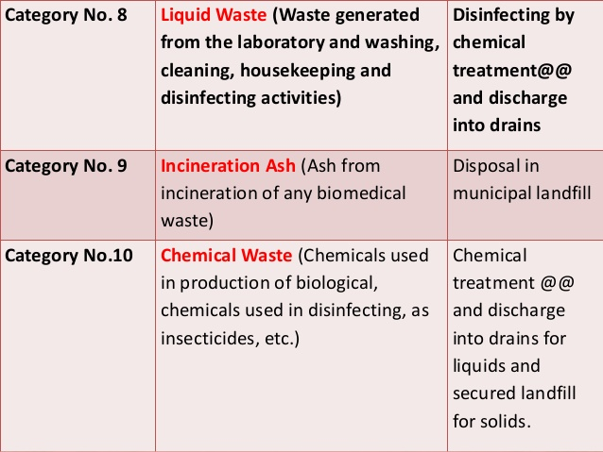

Slide 35
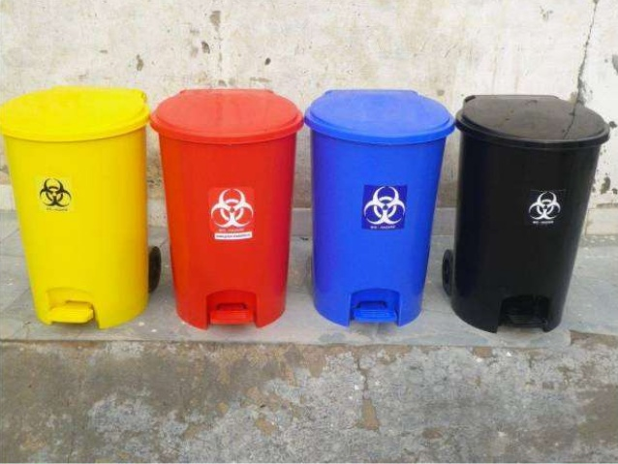

Slide 40
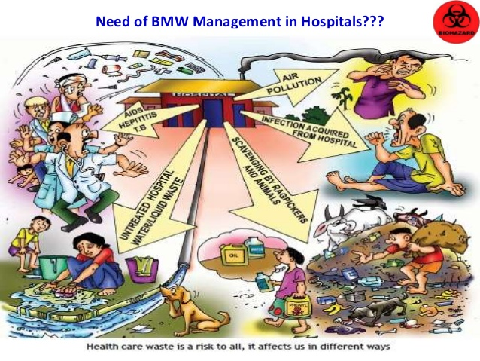

Slide 46
